Slide 1

LISTs & TUPLES
Jin Chang

Slide 2
Lists
List is a type of array that maintains multiple values in an ordered sequence regardless of their datatypes.
A collection of ordered and changeable values.
List index operator [] to access an item in a zeroth index. This means the 1st item is accessed with [0] not [1].

Slide 3
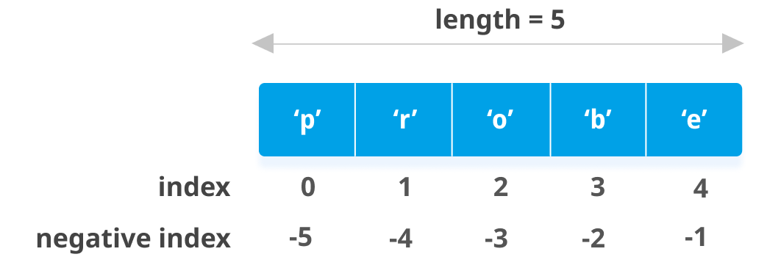
Lists
Negative indexing is also possible, -1 being the last item, “-” from the end, “1” first item. What would be -2?
Nested list is essentially 2D list, test[1][2], for instance, [[…], […], […]]
Multiple items can be accessed via [start:end] from start to end-1, ‘slicing’ (or extracting subset of the list).
Notes:
List_demo2.py

Slide 4
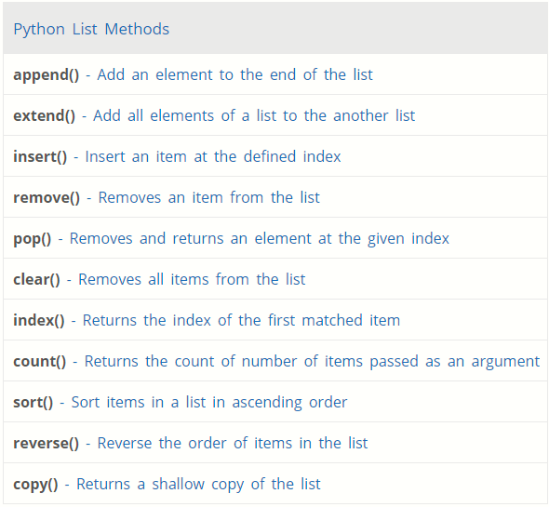
Lists Methods
Notes:
List_demo2.py
https://www.programiz.com/python-programming/list

Slide 5
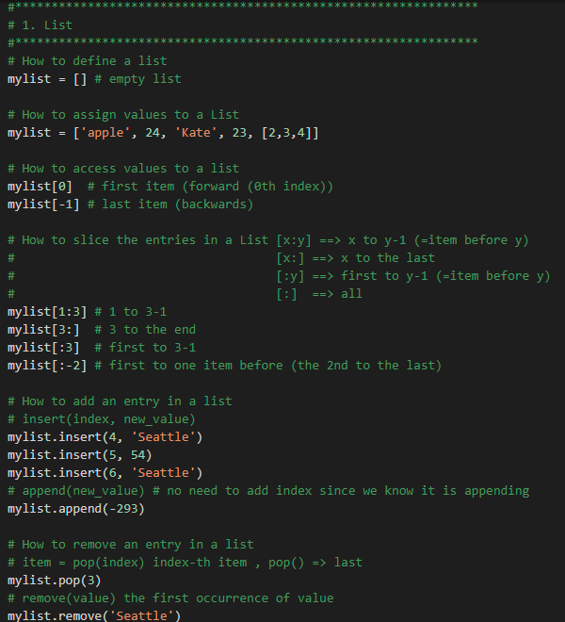
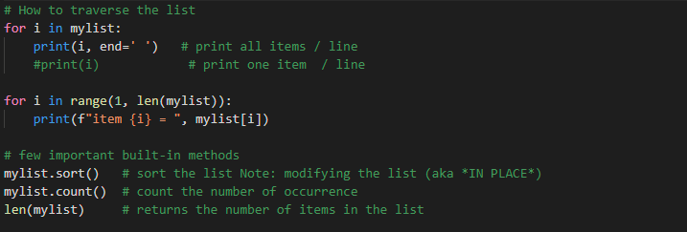
Try this for yourself in your own .py file
% python your_file.py

Slide 6
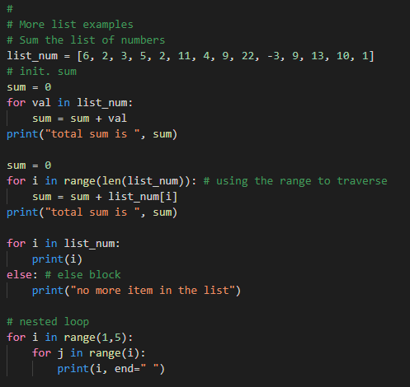
Try this for yourself in your own .py file
% python your_file.py

Slide 7
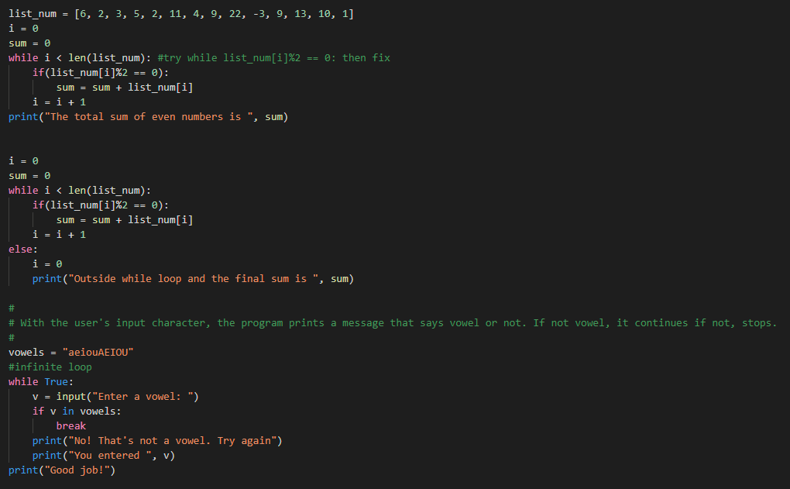
Try this for yourself in your own .py file
% python your_file.py

Slide 8
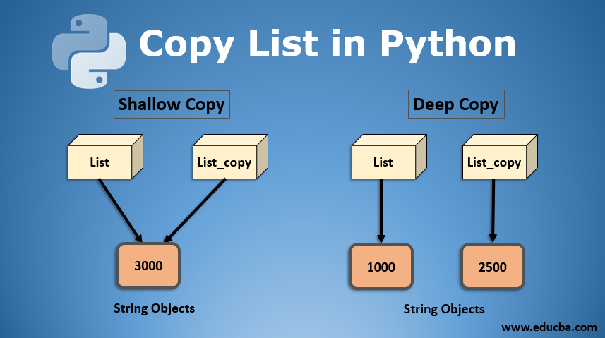
Shallow Copy and Deep Copy
Notes:
https://www.educba.com/copy-list-in-python/

Slide 9
Shallow Copy and Deep Copy (List)
Shallow copy creates a copy of the objects from the source
When the source changes the objects, both behave as independent sources in the first layer.
However, when the source changes the contents of the nested objects, then its new contents will be reflected into the copied object. Shallow copy is more like synching between 2 independent objects for the nested objects.
Shallow copy creates a copy of the objects but references the elements of the nested objects copied at the time of copy.
Deep copy creates a copy of the object and the elements of the objects as an completely independent object.
Any changes made to a copy of object will not be reflected.
Need to import copy module, and use copy.copy(src) for shallow copy and use copy.deepcopy(src) for deep copy.

Slide 10
Mutable and Immutable Data Types
“Mutable” means that you can modify the value such as list by using append, assignment, READ-WRITE.
“Immutable” means that you may not be able to change the value like string value, READ-ONLY.
List is “Mutable” as we all have seen by now.
List is a “mutable” datatype and Tuple is an “immutable.”
Check it for yourself the differences between list and tuple by using dir(L) and dir(T) where L is a list instance, and T is a tuple instance.

Slide 11
Tuple
A type of data structure consisting of multiple parts.
Similar to List, but there are 2 differences
‘cannot change’ the contents via direct assignment, =
‘can’ reuse or re-declare the tuple but cannot modify.
assignment is done using “()”.
access via indexing is done using “[]”.
Slicing is available.
List ⬅ ➔ Tuple, type conversion is also possible if needed.

Slide 12
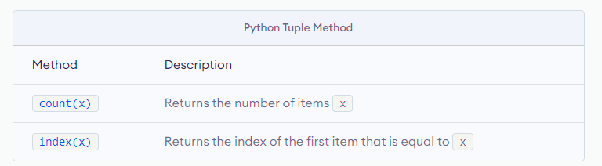
Tuple Methods
Because Tuple is “immutable”, it only supports very few methods to operate the datatype.
Notes:
List_demo2.py
https://www.programiz.com/python-programming/tuple

Slide 13
List and Tuple
Generally speaking, Lists are sequences of the same kind of things, and you deal with the items individually in order where the use of sort() makes sense.
>>> range(10)
[0, 1, 2, 3, 4, 5, 6, 7, 8, 9]
Generally speaking, Tuples are sequences of different kinds of things, and you deal with the tuple as a coherent unit in group where the use of sort() makes no sense.
>>> import time
>>> time.localtime()
(2008, 2, 5, 11, 55, 34, 1, 36, 0)
>>> RGB = (“R”, “FF0000”, “G”, “00FF00”, “B”, “0000FF”)
>>> def foo()
return (a, b, c)

Slide 14
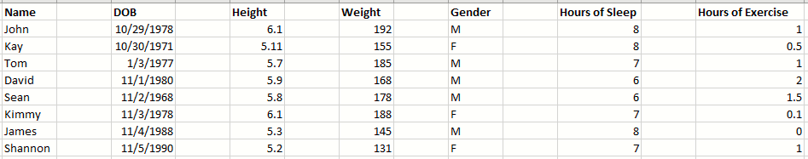
List and Tuple

Slide 15
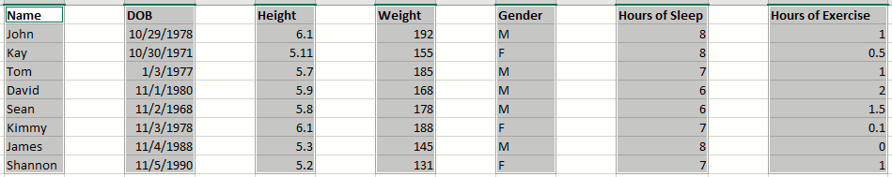
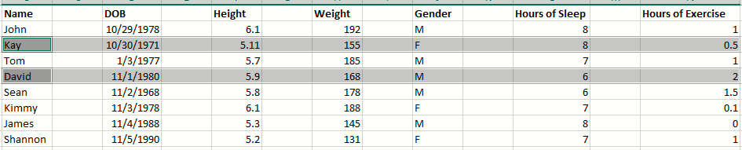
List and Tuple
Generally speaking, Lists are sequences of the same kind of things (HOMOGENOUS), and those individual values are functionally equivalent or same unit.
Generally speaking, Tuples are sequences of different kinds of things (HETEROGENOUS), and the position has the semantic values (Name, DOB, Height…).
Notes:
https://jtauber.com/blog/2006/04/15/python_tuples_are_not_just_constant_lists/

Slide 16
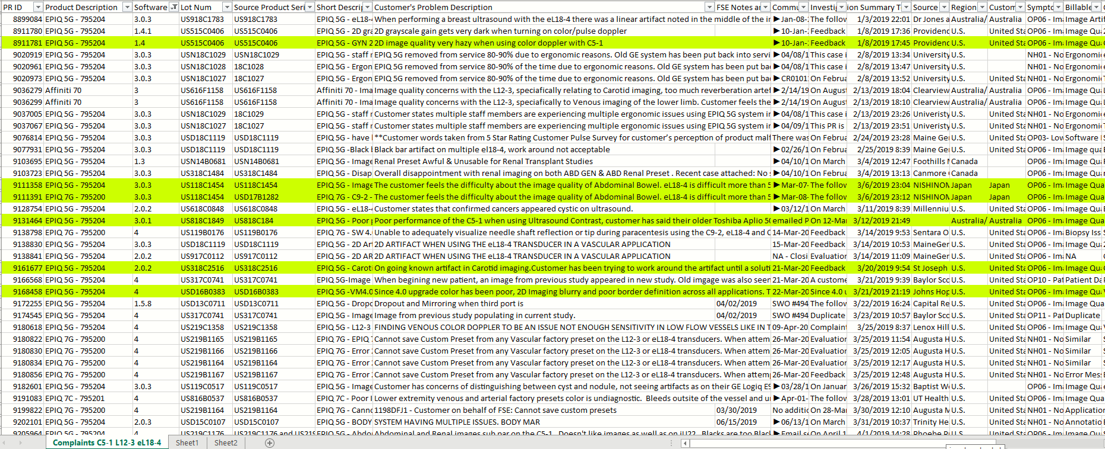
List and Tuple

Slide 17
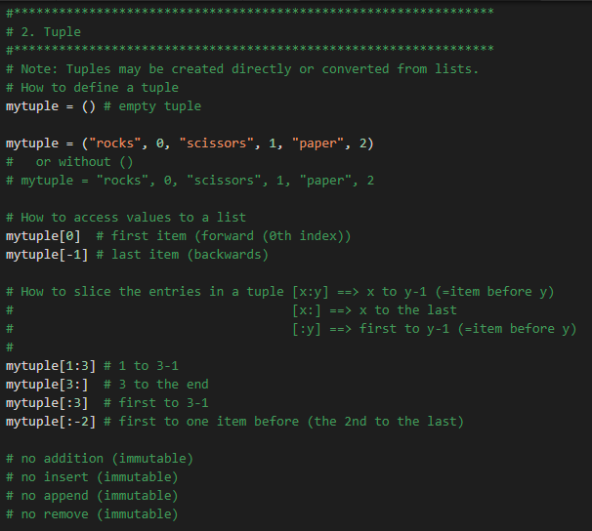
List and Tuple
% python your_file.py

Slide 18
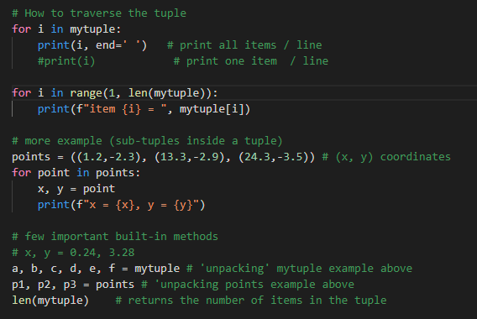
List and Tuple
% python your_file.py

